Slide 1
Midway Presentation:
On Empirical Comparisons of Optimizers for Deep Learning[1]
Group 10
Yoonwoo Jeong Jaejun Hwang Yunseon Choi
[1]Choi, Dami, et al. "On empirical comparisons of optimizers for deep learning." arXiv preprint arXiv:1910.05446 (2019).
Notes:
We’re group 10. What we gonna present is ‘On empirical comparisons of optimizers for deep learning’, arXiv 2019.

Slide 2
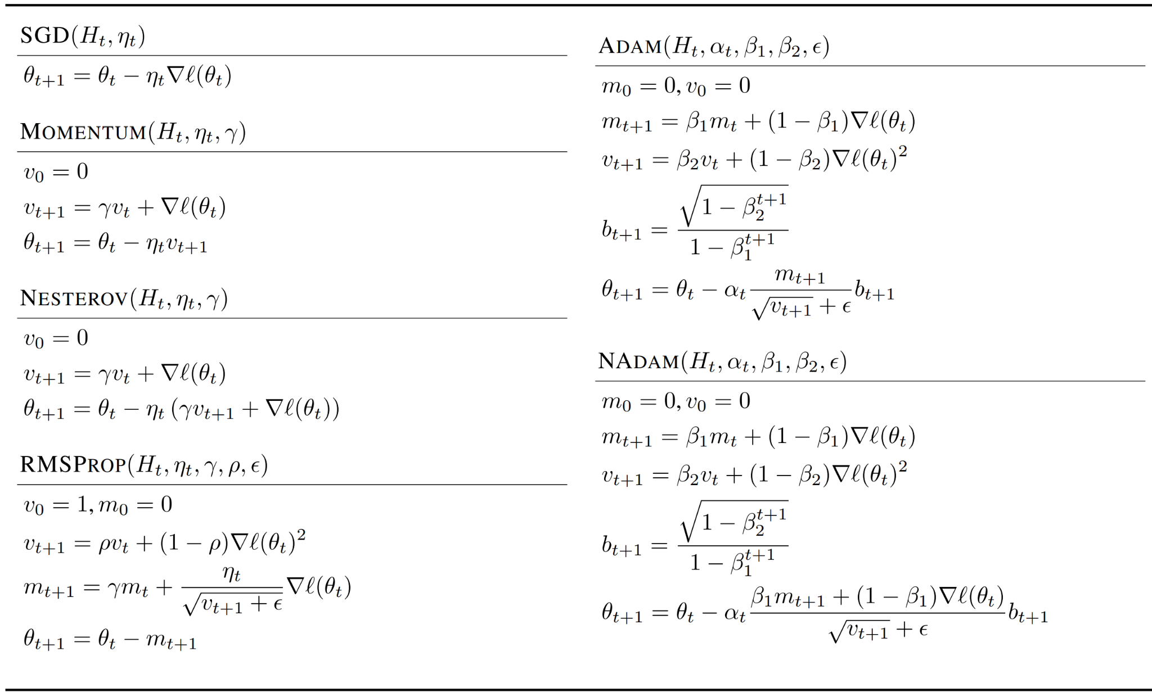
Abstract
On Empirical Comparisons of Optimizers for Deep Learning
The hyperparameter search space ⇒ Single most important factor explaining the rankings
With great tuning effort, Adam should never underperform momentum
Inclusion relationships between optimizers matters in practice
Notes:
The authors did lots of experiments with different optimizers and suggest that the hyperparameter search space is the single most important factor explaining the rankings.
They claims the more general optimizers like ADAM, ADGARD, RMSPROP never underperform the ones they can approximate such as SGD, MOMENTUM.
They suggest the inclusion relationships and found that inclusion relationships between optimizer matter in practice unlike previous studies.

Slide 3
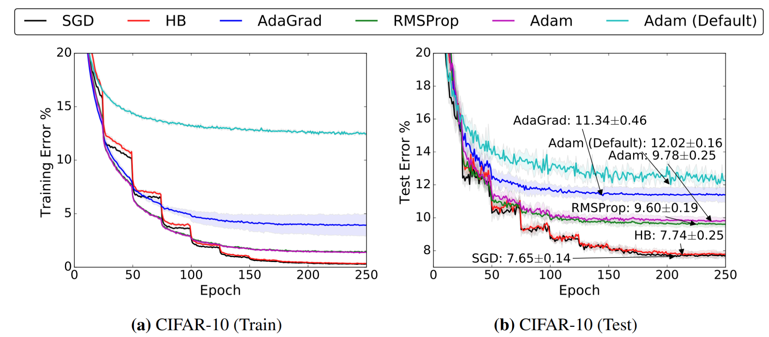
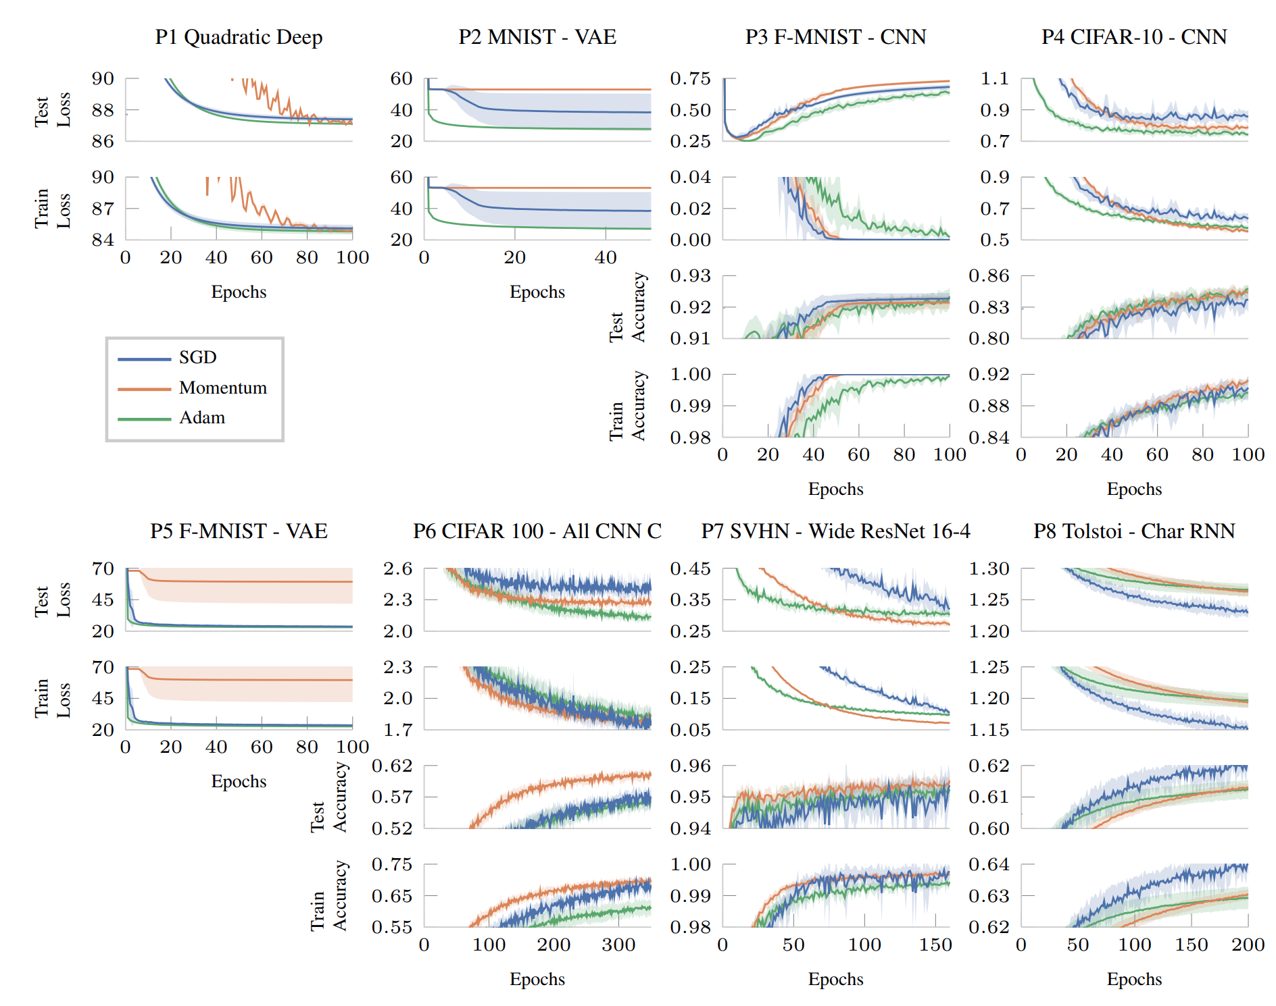
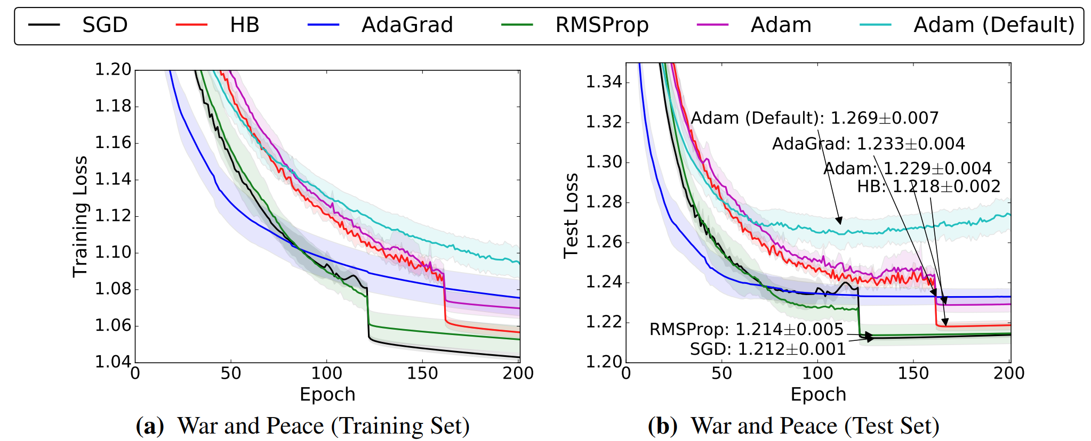
Intuition
Prior Problems
Wilson et al., The Marginal Value of Adaptive Gradient Methods in Machine Learning,
NeurIPS 2017
Schneider et al., DeepOBS: A Deep Learning Optimizer Benchmark Suite, arXiv 2019
Notes:
There are two empirical studies and benchmarking papers related to optimizer comparison.
Previous studies on optimizer comparisons show that ADAM, ADGARD, RMSPROP underperform SGD, MOMENTUM for Image classification and language modeling.
They pointed out there is a problem, because those experiments were performed with only learning rate tuning, and fixed default hyperparameters.

Slide 4
Intuition
Prior Problems
Notes:
The left pane of figure shows experiments reproducing Wilson’s code. With only grid search over the initial learning rate and no other tuning, SGD, MOMENTUM outperform the others like Wilson’s original experiments.
However tuning MOMENTUM parameter and epsilon with random search, there are no performance gap between optimizers.
They even get better performance with their own tuning.

Slide 5
Intuition
Prior Problems
Notes:
This figure shows the results with different tuning protocols for a CNN and LSTM in Schneider et al.
As reported by Schnedier et al, they only tune the learning rate without tuning the decay schedule or other optimizer hyperparameters.
But with hyperparameter tuning, it shows completely different results that Adam shows better performance than SGD, MOMENTUM.

Slide 6
Method
Inclusion Relationship
update rule M
Some optimizers can approximately simulate others
If two optimizers have an inclusion relationship, the more general optimizer can never be worse with respect to any metric of interest, provided the hyperparameters are sufficiently tuned to optimize that metric
Notes:
There is a detailed idea.
They start with observation that some optimizers can approximately simulate others.
They define that the following inclusion relationship between optimizers.
M, N are update rules for use in a first-order optimization method. M is a subset or specialization of N, if for all phi, there exists a sequence psi, such that for all t and histories.
For example, MOMENTUM includes SGD, so MOMENTUM with 0 gamma, the next update of MOMENTUM is same as SGD.
Likewise, RMSPROP could include MOMENTUM and SGD, NADAM include NESTREROV and SGD.
Some of these inclusion make use of the flexibility of hyperparameter schedules. For example, to approximate MOMENTUM with ADAM, one needs to choose a learning rate schedule that accounts for ADAM’s bias correction.
And if two optimizers have an inclusion relationship, the more general optimizer can never be worse with respect to any metric of interest, with sufficient hyperparameter tuning.

Slide 7
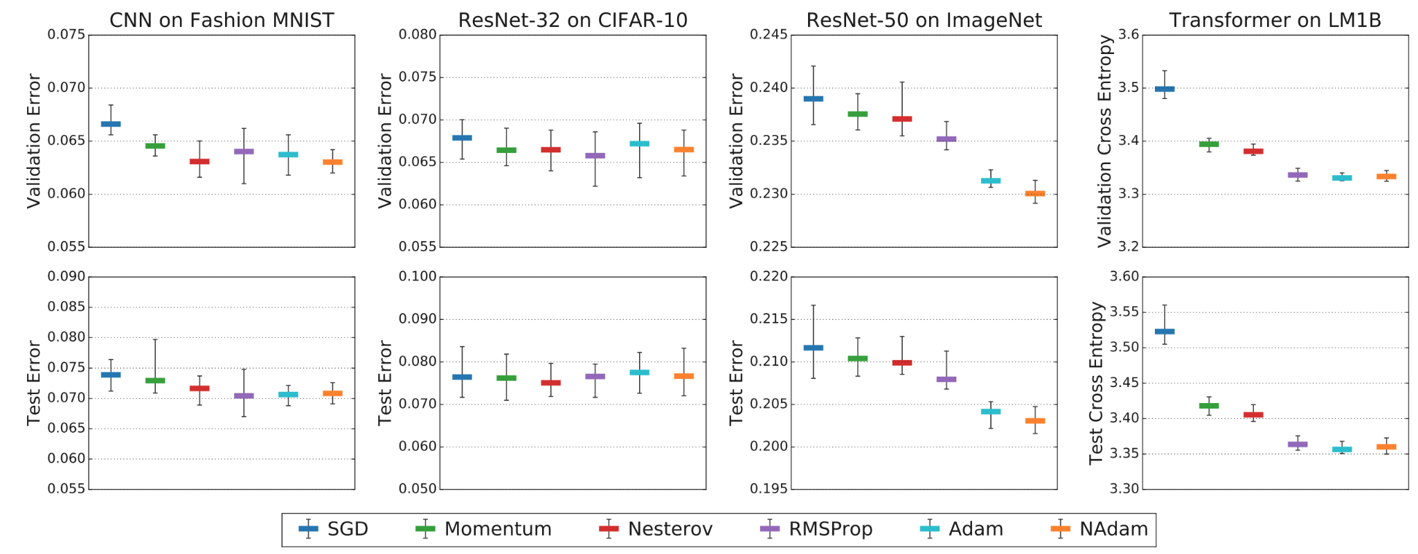
Method
Experiments
Notes:
There are the results for image classification and language modeling. They experiments on lots of models and dataset.
They set the target error to compare different optimizers in same condition.
In particular, they achieved a validation accuracy of 77.1% for ResNet-50 on ImageNet using NADAM with epsilon=9475.
As you can find, the general method never underperform the one they can approximate. RMSProp shows better performance than MOMENTUM and SGD, ADAM / MOMENTUM / SGD same, NADAM / NESTEROV / SGD same.

Slide 8
Relevance
Related to the Research paper
Our Research: Optimization is All You Need
Empirical comparisons of different optimizers
Measuring the robustness of optimizers with aritificially noise added data
Measuring the performance on problem that only a few of the parameters participate on the updates for each step
Research Paper: On Empirical Comparisons of Optimizers for Deep Learning
Suggesting that previous studies have setting problems causing unfair ranking comparisons
There is no absolute outperforming optimizer
Related
Rethinking the performance and effects of optimizers
Setting experiments clearly to compare performance or effects only regarding what we deal with
Notes:
We‘re planning to compare different optimizers in specific condition. First is training on artificially noise-added data. Second is training the network with different dropout ratio.
On research paper, they threw a doubt on prominent results of optimizer comparisons. Likewise, we rethink the effects of optimizer and plan to figure out it empirically.
We are influenced by their comparison methodology. When comparing performance of optimizers, which variable is independent or dependent for experiments is most important to get fair result.
Even with good performance, it would not be the right comparison if this was due to the hyperparameter.
So with those idea, we will plan to compare their performances fair enough.

