Slide 1
THE LOTTERY TICKET HYPOTHESIS
Finding Sparse, Trainable Neural Networks
Team 4
Taegyu Park, Byeongju Woo
May 11, 2022
Notes:
Hello, we are Park Tae-Gyu and Woo Byung-Joo from group 4, who will present the Lottery Ticket Hypothesis.

Slide 2
Table of Contents
Introduction
Intuition and Algorithm
Experiments
Conclusion
Our project
Notes:
We will first introduce the paper first, and then we’ll link the paper to our project briefly.

Slide 3
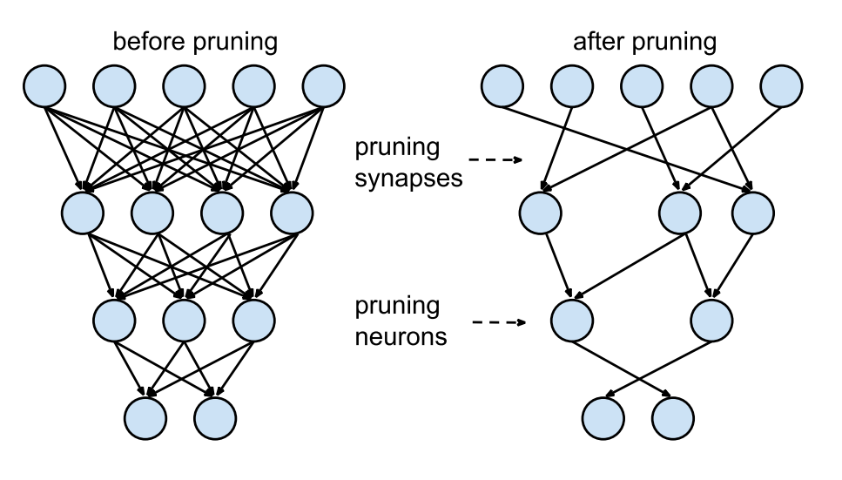
Network pruning
Introduction
Neural network pruning techniques can reduce the parameter counts of trained network by over 90%
Decreasing storage requirements
Improving computational performance of inference without compromising accuracy
Han, S., Pool, J., Tran, J., & Dally, W.J. (2015). Learning both Weights and Connections for Efficient Neural Network. ArXiv, abs/1506.02626.
Notes:
Network pruning is a technique that lightens the model by removing some connections that are considered weaker than others in the deep learning model. As of 2019, when this paper was published, the neural network pruning technique made it possible to reduce parameters to more than 90%. And in this process, it not only significantly reduces the storage capacity but also significantly improves computational performance with slight accuracy loss. Performance is maintained or improved even if you remove a lot of network connectivity means that traditional neural networks are too dense, and many connections are redundant for interference.

Slide 4
Training Pruned Model?
Introduction
If a network can be reduced, why do we not train this smaller architecture, not only for inference?
Training a pruned model from scratch performs worse than retraining a pruned model, which may indicate the difficulty of training a network with a small capacity.
prune
Random weight initialization
90% accuracy
~90% accuracy
Random weight initialization
🤔
60% accuracy
Liu, Z., Sun, M., Zhou, T., Huang, G., & Darrell, T. (2019). Rethinking the Value of Network Pruning. ArXiv, abs/1810.05270.
Notes:
However, if you learn the network found through pruning using random weight from scratch, its accuracy was far less than the accuracy of the model obtained by pruning and this was the problem. There have been many speculations about this, and the most plausible argument is that the network found through pruning has a small capacity due to the small number of parameters, so it is harder to learn than the existing network with many parameters.

Slide 5
The Lottery Ticket Hypothesis
Intuition
prune
Random weight initialization
90% accuracy
~90% accuracy
There will be at least one subnetwork that has similar performance to the original network
Some weight initialization
~90% accuracy?
Finding that subnetwork with initialized weights is same with finding initialization winning ticket in lottery
Notes:
We can make one guess here. If the pruned network performs similarly to the original network, we can say that at least one subnetwork exists for the artificial neural network that has almost the same performance as the original neural network. So, if we start training that subnetwork using a specific initial value, wouldn't we be able to grow into a model that has similar performance even if it has a smaller capacity than the original one? Even though it's hard to find that initial value.

Slide 6
The Lottery Ticket Hypothesis
Intuition
The Lottery Ticket Hypothesis
A randomly-initialized, dense neural network contains a subnetwork that is initialized such that—when trained in isolation—it can match the test accuracy of the original network after training for at most the same number of iterations.
→ We want to find the Winning ticket !
Notes:
Based on the results mentioned before, the authors propose a new concept. The Lottery Ticket Hypothesis is that the dense, randomly-initialized, feed-forward network has a subnetwork - a winning ticket - with similar test performance to the original network after training a similar number of iterations. The winning ticket we found is the same as winning the initialization lottery. These networks will have initialized weights that will enable learning to be effective. That is, among many subnetworks, there should be at least one subnetwork that works well as the original one. This is a metaphor for winning the lottery.

Slide 7
The Lottery Ticket Hypothesis
Intuition
The Lottery Ticket Hypothesis
Assume initial parameters are the same.
$f\left(x;θ_{t}\right)$ has accuracy $a$ with minimum validation loss.
$f(x;m⊙θ_{t^{′}})$ has accuracy $a′$ with minimum validation loss.
$m$ is a ‘mask’.
$∃m$ s. t. $∑m≪\left|θ\right|,a^{′}≥a,t^{′}≤t$
→ We want to find the Winning ticket !
Notes:
We can formularize the Lottery Ticket Hypothesis like this. Let's say an original model achieves minimum validation loss in step t with accuracy a. Starting from the same initial parameters, there is a pruned model that achieves minimum validation loss in step t' with accuracy a' where t'<=t and a'>=a. Here, m denotes a parameter mask, so f of m dot theta is a pruned network.

Slide 8
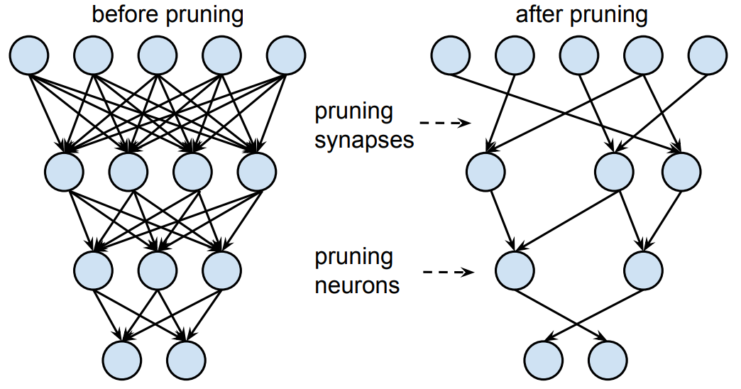
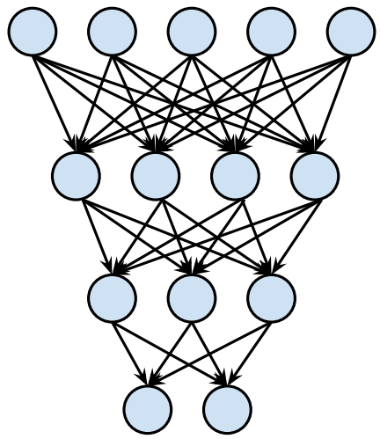
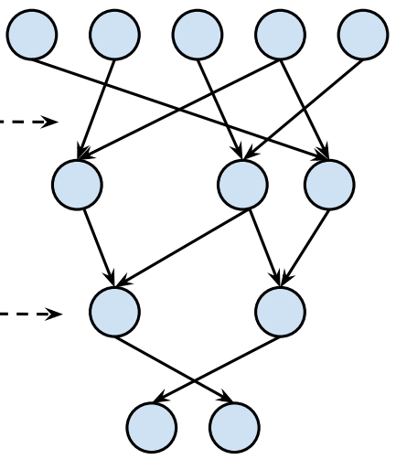
Identifying Winning Tickets
Algorithm
Same algorithm with general network pruning except each unpruned connection’s value is reset to its initialization from original network before it trained
1
2
3
4
Randomly initialize a network,
$f(x;θ)$ where $θ_{0}\sim 𝒟_{θ}$
Train network and get parameters the $θ_{j}$
$$j≔\#iterations$$
Prune $p^{\frac{1}{n}}\%$ of parameter $θ_{j}$, creating a mask $m$
Reset the remaining parameters to their values in $θ_{0}$
→ Winning ticket
Notes:
Here's how to find the winning ticket. The algorithm follows these 4 steps, and from step 1 to step 3 is the same as the general network pruning method, which initializes a network, trains the network, and prune and finetuning N times iteratively for total p% prune. However, in the last step, they reset the remaining parameter of the pruned network to the original parameter, theta_0, and this is the iterative approach of getting the winning ticket.

Slide 9
Identifying Winning Tickets
Experiments
Experiments for finding winning tickets
Winning Tickets in Fully-connected network
Winning Tickets in Simple Convolution Network
Winning Tickets in Deep Convolution Network
Figure. Architectures tested in this paper
Notes:
Were these networks really a winning ticket?
The authors found winning tickets by applying algorithms to fully connected networks and convolution networks.

Slide 10
Experiment 1. FC(LeNet) for MNIST
Experiments
Layer-wise pruning, iterative pruning
Figure. Test accuracy on LeNet for MNIST. 5 trials.
Notes:
The first experiment was to find the winning ticket on the FC layer, and the author evaluated the performance by applying LeNet to the MNIST task. The graph shows the test accuracy when layer-wise iterative pruning was performed, and it shows the highest test accuracy when it was pruned up to 21.1%. Even when it's pruned up to 3.6%, the model still was the winning ticket. On the other hand, the winning ticket could not be found when random initialization was applied.

Slide 11
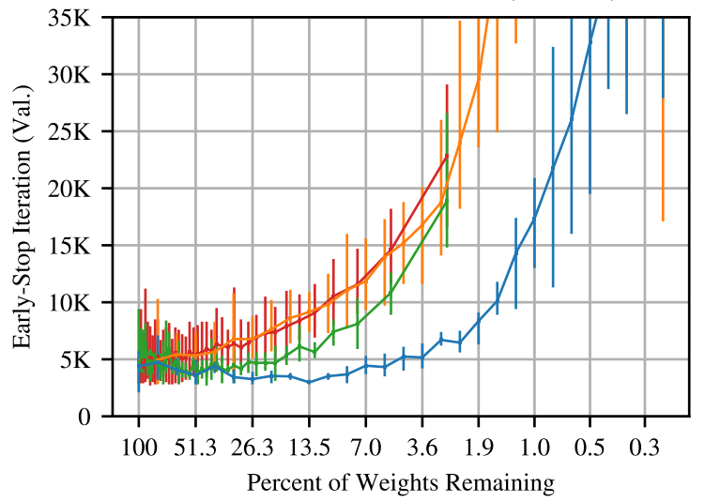
Experiment 1. FC(LeNet) for MNIST
Experiments
Layer-wise pruning, iterative pruning
Figure. Early-stopping iteration and accuracy for all pruning methods.
Notes:
Not only the test accuracy was good, but we can also confirm that winning tickets converge more quickly. When comparing orange and blue, we can see that the winning ticket is shorter - closer to zero - in almost all parameter remaining ratios than those randomly initialized.

Slide 12
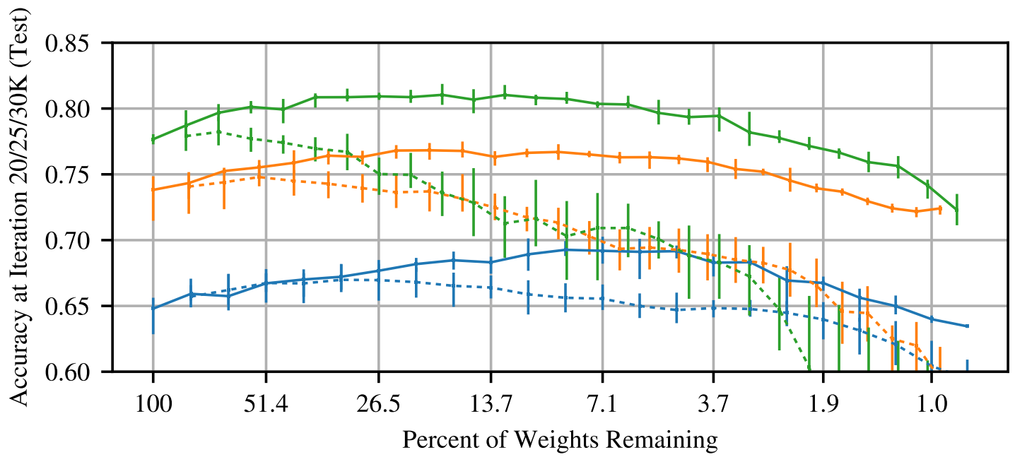
Experiment 2. Simple ConvNet for CIFAR10
Experiments
Layer-wise pruning, iterative pruning
Figure. Test accuracy on conv-2/4/6 for MNIST. 5 trials.
Drop out also improved the performance
Notes:
In the second experiment, we tried to find the winning ticket in the scaled-down versions of VGG, Conv-2, Conv-4, and Conv-6 architectures. Those were evaluated in the CIFAR10 task, and similarly, all three architectures show a higher test accuracy than randomly reinitialized counterparts.

Slide 13
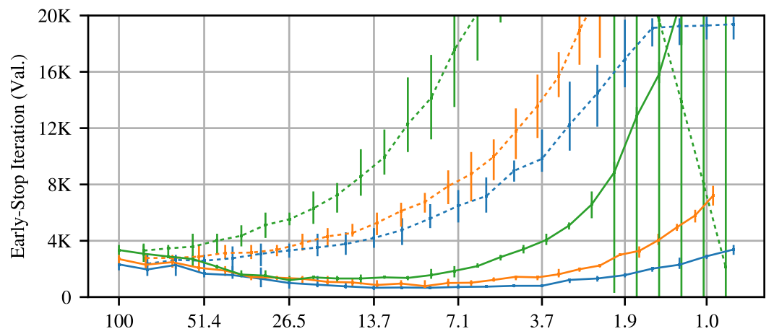
Experiment 2. Simple ConvNet for CIFAR10
Experiments
Layer-wise pruning, iterative pruning
Figure. Early-stopping iteration and accuracy
Notes:
Likewise, winning tickets quickly converged in fewer iterations.

Slide 14
Experiment 3. VGG19, ResNet18 for CIFAR 10
Experiments
global pruning(since #parameter in each layer are quite different) , iterative pruning
Figure. Test accuracy (at 30K, 60K, and 112K iterations) of VGG-19 when iteratively pruned
#Params in 1st layer of VGG19 : 1728 → Can be bottleneck
#Params in last layer of VGG19 : 2.35 million
Notes:
It was also successful in deeper networks, but in this experiment, the global pruning technique was used to prune throughout the network, rather than layer-wise pruning. There are significant performance differences depending on how the learning rate is adjusted, suggesting that a more heuristic method is needed for a slightly deeper network.

Slide 15
Discussion
Conclusion
Importance of winning ticket initialization
→ Benefit of Initialization is connected to the optimization algorithm, dataset, and model
→ winning ticket initialization might land in a region of the loss landscape that is particularly amenable to optimization by the chosen optimization algorithm
The existence of the winning ticket
→ Author conjecture that over-parameterized networks are easier to train because they have more combinations of subnetworks that are potential winning tickets
Further studies…
Notes:
In summary, the paper states that winning ticket initialization are associated with an optimization algorithm, dataset, and model, thus explaining that proper initialization can land in some area on the loss landscape suitable for the optimization. Eventually, this paper showed the existence of a winning ticket that can achieve the same performance by re-learning even if pruned. The authors also argued that the more over-parameterized the network, the easier it is to find the winning ticket. Subsequent studies also found winning tickets in NLP and RL, providing much cheaper methods than those suggested in this paper.

Slide 16
Convergence Rate of Attention Mechanism with Ablation
Brief introduction of our project & Relevance with presented paper
Team 4
Taegyu Park, Byeongju Woo
May 11, 2022
Notes:
The reason why we introduced this paper related to our project is that we want to compare the loss landscape of transformer and its winning ticket.

Slide 17
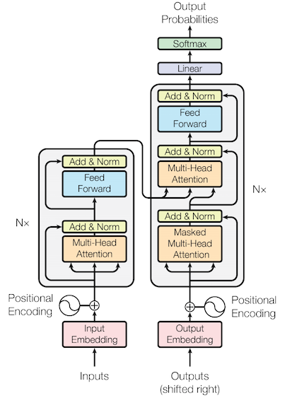
Transformer pruning
Our Project
Transformer has too many parameters, easy to over-parameterized
We just wanted to investigate the convergence in the situation where some part of the Transformer is removed(pruned)
Unfortunately, no equations (time complexity, bound) related to convergence of pruning techniques could be found
Instead, we will visualize loss landscape of 1) Original Transformer
2) Pruned Transformer without compromising accuracy
* We want to visualize loss landscape of winning ticket of transformer !
Notes:
Previous studies have revealed that transformers are generally heavy and over-parameterized. Therefore, we want to investigate the convergence of subnetwork pruned transformer.
However, for the pruning technique in general, we could not find a paper that strictly justified the bounds of time complexity or loss error. Therefore, we want to obtain subnetwork using the method of the paper and investigate how it affects convergence rate in the loss landscape.

Slide 18
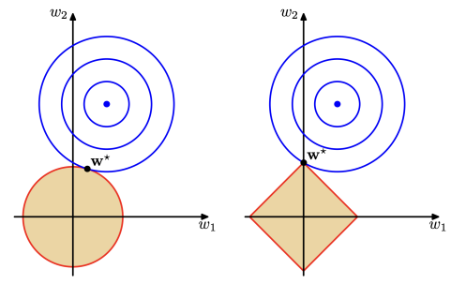
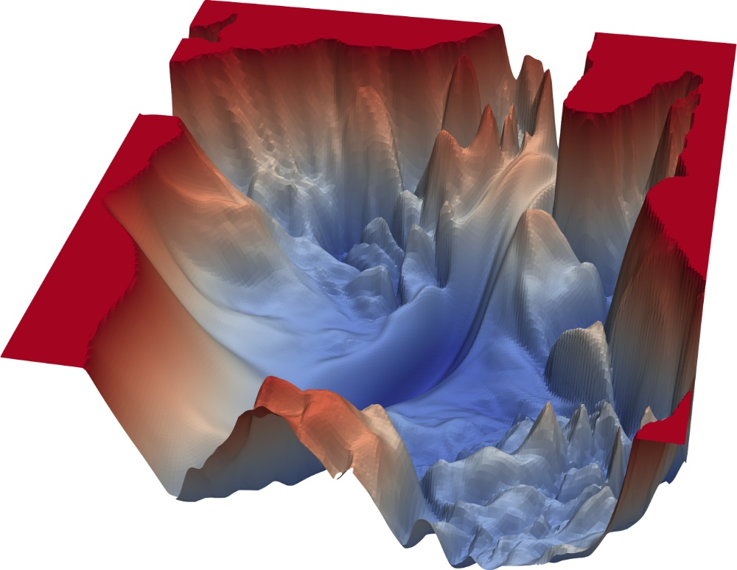
Transformer pruning
Our Project
How is the loss landscape of winning ticket different when using L1,L2 regularization, respectively?
How is the loss landscape of winning ticket different when using SGD, Adam, AdaDelta, respectively?
How is the loss landscape of winning ticket different if re-init parameter with random, theta_0, theta_0’ (theta_0’ indicates a little trained parameter from original network)
Notes:
Paying attention to the fact that weights tend to be zero under the L1 regularization, we can compare what kind of difference there will be in L1 and L2 regularization. Also, it can be compared according to optimization algorithms such as SGD, Adam, and AdaDelta, and it can be compared according to how the re-init parameter is set.

Slide 19
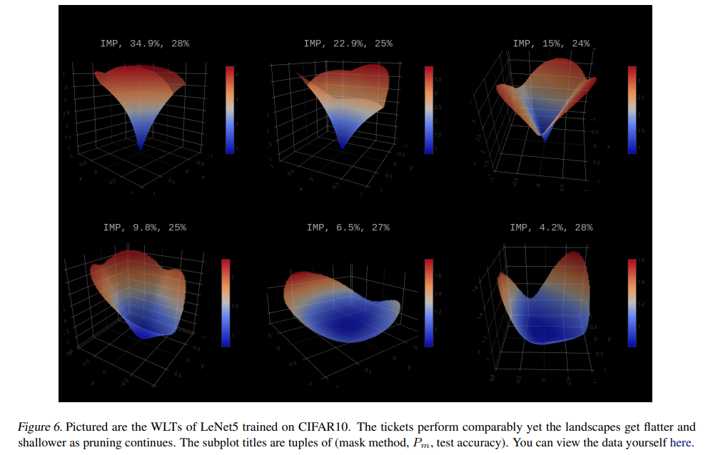
Related works
Topic
Notes:
Lastly, in relation to our project, it is likely that you will be able to participate in the study of a paper that visualizes the loss landscape of LeNet's winning tickets.

Slide 20
Thank you for listening ☺
Taegyu Park, Byeongju Woo
Notes:
That is all and thank you for listening to our presentation.

