Slide 1
LassoNet: Neural Network with Feature Sparsity (AISTATS 2021)
2022/05/18
Jinhwan Seo
Notes:
Hello, my name is Jinhwan Seo who will deliver presentation of LassoNet: Neural Network with Feature Sparsity today.

Slide 2
Introduction
They introduce LassoNet, a neural network framework with global feature selection.
The method extends lasso regression and its feature sparsity to feed-forward neural network.
In experiment, LassoNet selects the most informative pixels on a subset of MNIST dataset, and classifies the original images with high accuracy.
Notes:
Let me briefly introduce key ideas of this paper
They introduce LassoNet that performs global feature selection on neural network which is generally formulated as non-linearity functions.
The method achieves feature sparsity on neural network by extending lasso regression.
As a result, some qualitative results show us that LassoNet successfully select the most informative pixels on MNIST dataset.

Slide 3
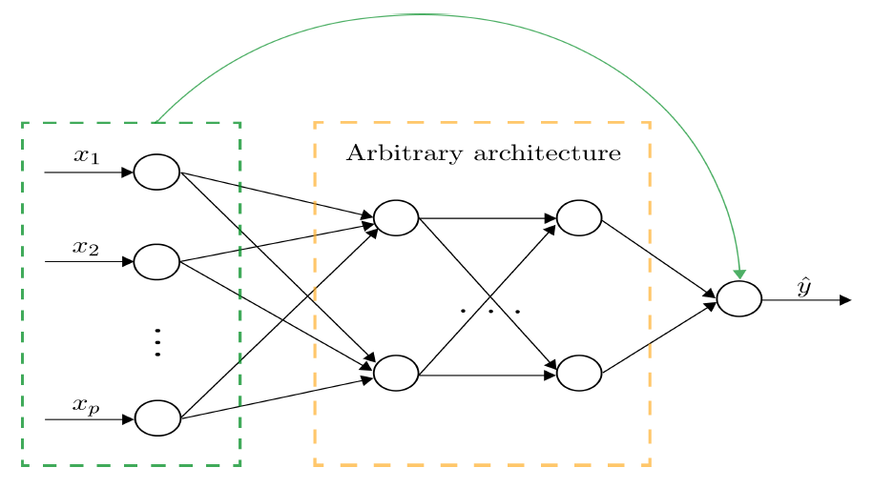
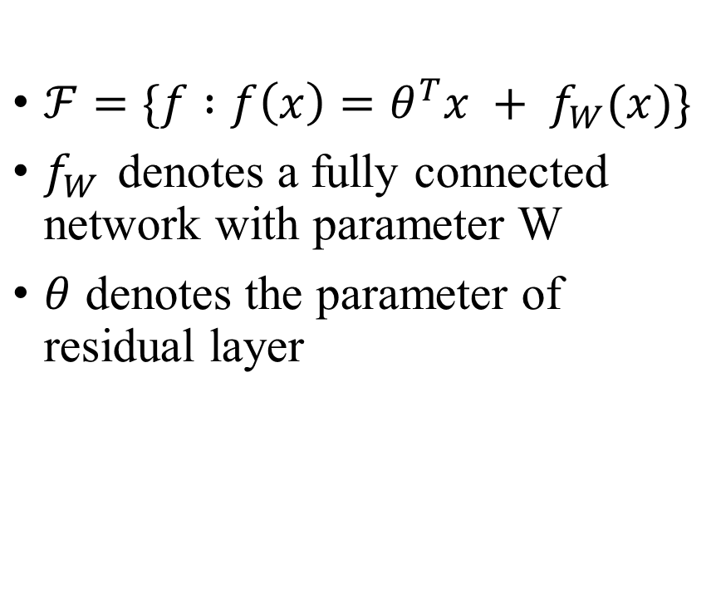
Method
$ℱ=\{f :f\left(x\right)=θ^{T}x + f_{W}(x)\}$
$f_{W}$ denotes a fully connected network with parameter W
$θ$ denotes the parameter of residual layer
Notes:
The overall architecture of LassoNet is shown as like this.
Residual feed forward network can be written as F. with the linear function theta(transpose) x which indicate green part on the picture and the feed forward network f with parameter W. and x is input data.
The first hidden layer of arbitrary architecture is the one that the method focus on for selecting features from input not inside of the network.

Slide 4
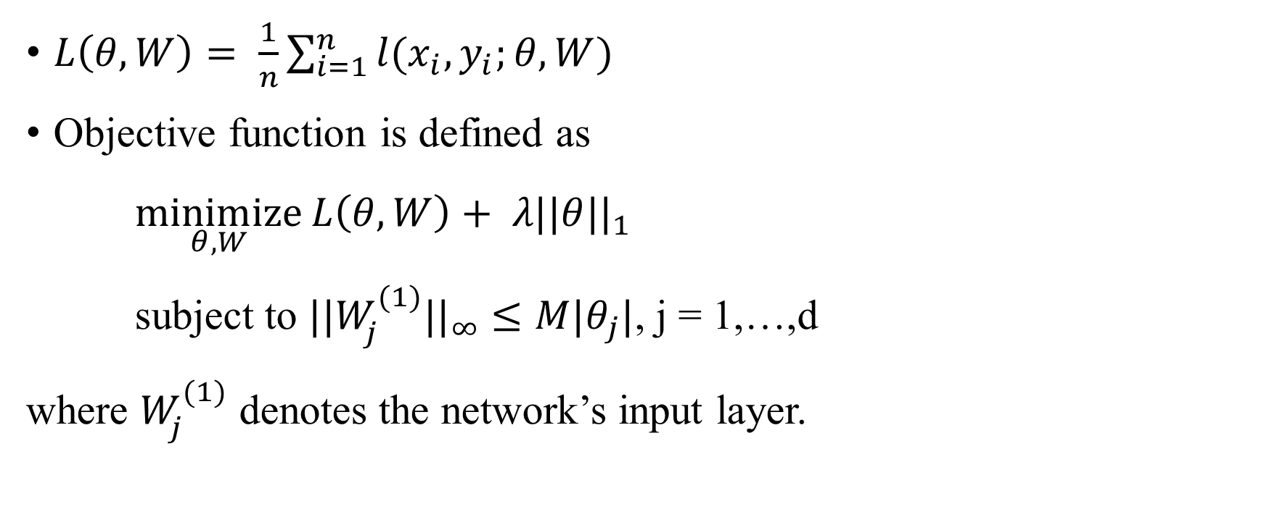
Method
$L\left(θ,W\right)= \frac{1}{n}\sum_{i=1}^{n}{l(x_{i},y_{i};}θ,W)$
Objective function is defined as
$\underset{θ,W}{minimize}{L\left(θ,W\right)+ λ||θ||_{1}}$
subject to $||W_{j}^{(1)}||_{∞}$ $≤M|θ_{j}|$, j = 1,…,d
where $W_{j}^{(1)}$ denotes the network’s input layer.
Notes:
Here is a loss with respect to the parameter theta and W.
Then, We want to minimize this loss with the l1 norm penalty of linear component theta. Non-linear component W is constrained by theta with coefficient M.
Here the superscript (1) denotes the first layer of neural network
To make sure that the entire model is sparse, we give a constraint on non-linear coefficient which is neural network part by linear component theta.

Slide 5
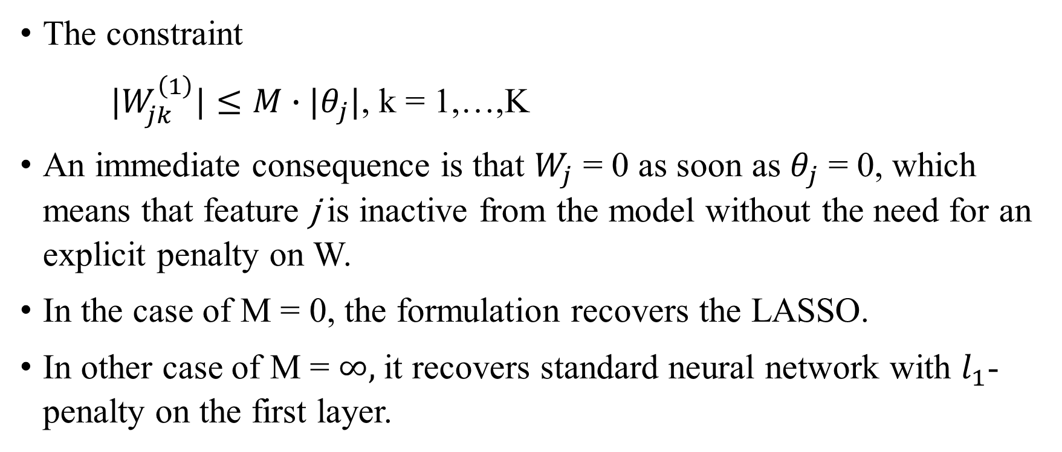
Method
The constraint
$|W_{jk}^{\left(1\right)}|≤M∙|θ_{j}|$, k = 1,…,K
An immediate consequence is that $W_{j}$ = 0 as soon as $θ_{j}$ = 0, which means that feature j is inactive from the model without the need for an explicit penalty on W.
In the case of M = 0, the formulation recovers the LASSO.
In other case of M = $∞$, it recovers standard neural network with $l_{1}$-penalty on the first layer.
Notes:
We can see that the parameter W which involves every single input feature according to the relative effective importance. Then the weight set to be zero as soon as the linear component become 0.
the j-th feature can be inactive without the penalty on W.
When the coefficient M become 0, the formulation is exactly same as original lasso
In opposite case when M goes infinity, it becomes standard neural network with l1 penalty on the first layer.

Slide 6
Method
LassoNet has two hyperparameter:
The $l_{1}$-penalty coefficient, $λ$, controls the complexity of the fitted model; higher values of $λ$ encourage sparser model
The hierarchy coefficient, M, controls relative strength of the linear and nonlinear components.
Notes:
The author introduce two hyperparameter to make LassoNet success.
Lambda is l1 norm penalty coefficient, which controls complexity of model.
Higher value of lambda encourage sparser model.
The coefficient M controls relative strength of linear and non linear components.

Slide 7
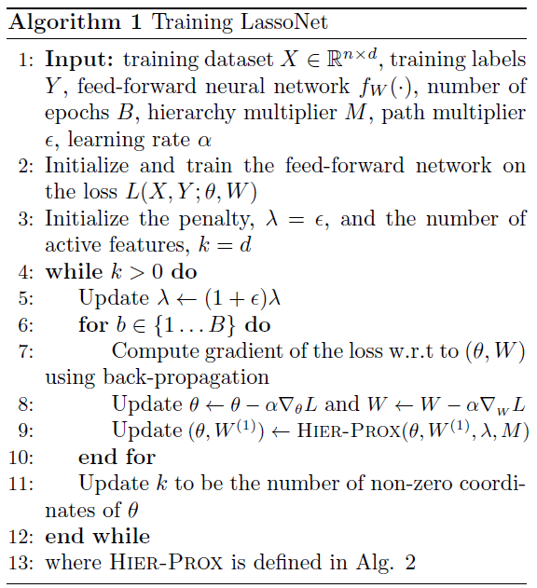
Method
Notes:
Here is the training algorithm of LassoNet.
As we can see here, we increase the lambda path that is we regularize model more dense-to-sparse

Slide 8
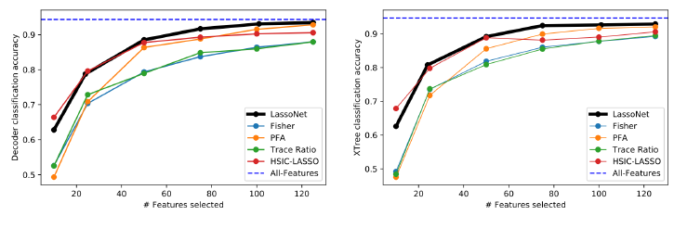
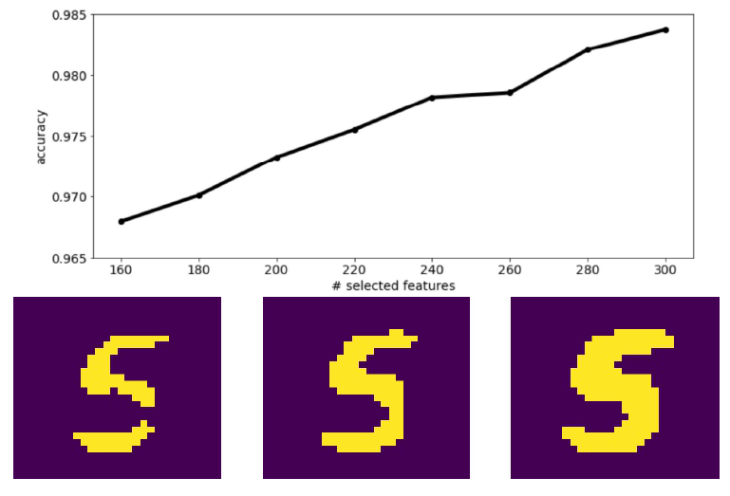
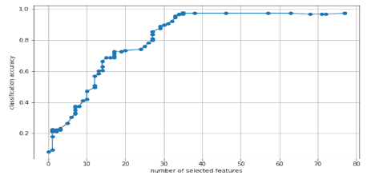
Results
Figure:2 Comparison with other feature selection methods on ISOLET dataset
Figure1: Demonstrating LassoNet on the MNIST dataset
Figure3: Feature selection path produced by LassoNet on MICE protein dataset.
Notes:
Figure 1 shows the result of LassoNet to select informative pixels. The graph is the classification accuracy by the number of selected features. 3 samples from the model with 84, 110 and 158 features out of 784 features.
Figure 2 compares accuracy on ISOLET dataset with other feature selection methods. LassoNet achieves the high accuracy compare with other methods.
Figure 3 shows a trade-off between the number of feature and statistical performance on protein dataset. In this example, the method captures 70% of signals with about 20% of features.

Slide 9
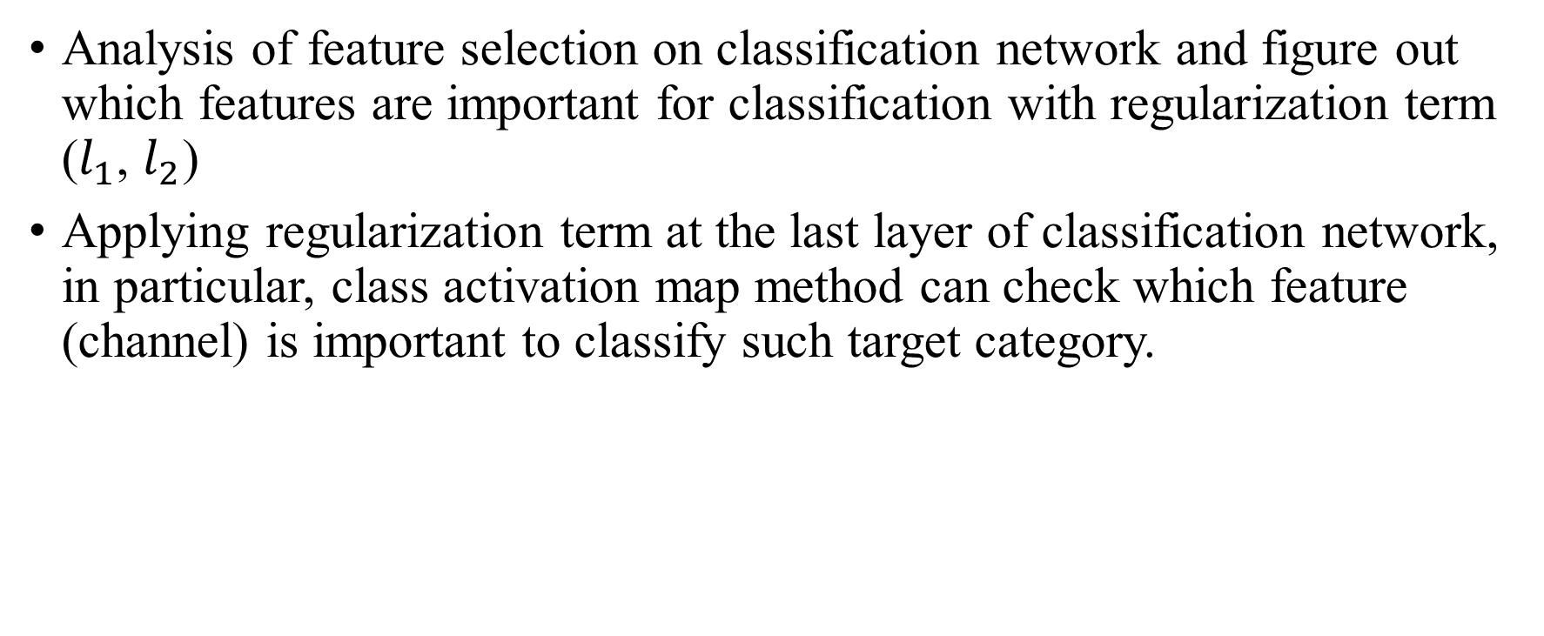
Final Project
Analysis of feature selection on classification network and figure out which features are important for classification with regularization term ($l_{1}$, $l_{2}$)
Applying regularization term at the last layer of classification network, in particular, class activation map method can check which feature (channel) is important to classify such target category.
Notes:
What I would like to focus is that when we train the classification network model, which part (activation map) is important to classify such target category. We approximately estimate the prediction of localization only trained on classification network using class activation map method.
If we consider the inference time of class activation map, regularized weight of last layer can predict which channel is important for classification. I will analyze the distribution of regularized weight and its corresponding activations.

Slide 10
Thank you for listening

