Slide 1
On the Neural Tangent Kernel of Deep Networks with Orthogonal Initialization
Wei Huang, Weitao Du, and Richard Yi Da Xu
IJCAI 2021
Presenter : Jaechang Kim, Jabin Koo

Slide 2
Introduction
Project Topic: An Analysis of Neural Network Initializations using Neural Tangent Kernel.
Paper Title: On the Neural Tangent Kernel of Deep Networks with Orthogonal Initialization
Summary of topic: Empirical study on various neural network initialization methods with Neural Tangent Kernel

Slide 3
Contents
Paper
Backgrounds
Motivation
Theoretical results
Experimental results
Conclusion
Project
Motivation
Method

Slide 4
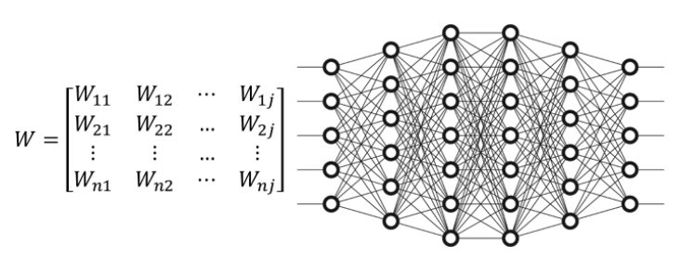
Background: Neural Network Initializations
There are various ways of neural network initializations in used.
Constant Initialization
Gaussian distribution
Uniform distribution
Orthogonal Initialization
Depending on the layer width and the activation function, different initializations are known to be effective.

Slide 5
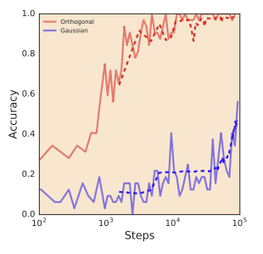
Background: Orthogonal Initialization
Orthogonal initialization initializes neural network weights as orthogonal matrices. i.e), $W^{T}W=I.$
It is known that orthogonal initialization speeds up training of deep neural networks due to Dynamical Isometry and is especially useful in recurrent neural networks.

Slide 6
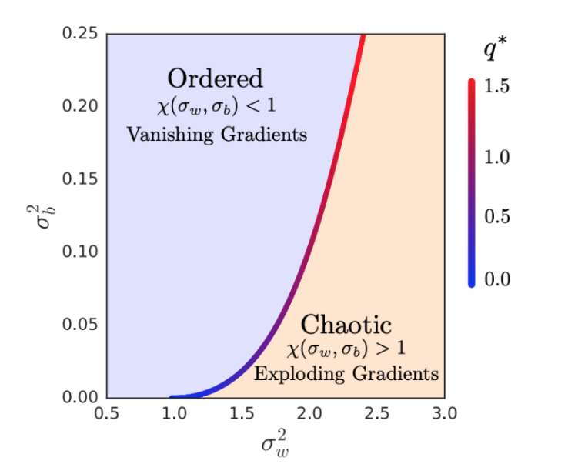
Background: Dynamical Isometry
When a neural network achieves dynamical isometry, the gradients avoid exploding/vanishing gradients.
Dynamical Isometry happens when the singular values of the input-output Jacobian for weight matrices equal one.
Recent researches suspect that orthogonal Initialization achieves the dynamical isometry.
Theoretically well-proven for linear networks, but not for non-linear networks.
Dynamical Isometry and a Mean Field Theory of CNNS: How to Train 10,000-Layer Vanilla Convolutional Neural Networks, ICML 2018

Slide 7
Background: Neural Tangent Kernel
In the infinite-width scheme, a training dynamics of neural network is approximated by a kernel, named Neural Tangent Kernel, which converges into a deterministic kernel.
Recently, NTK framework is being used as a theoretical backgrounds for understanding deep learning.
Why Do Deep Residual Networks Generalize Better than Deep Feedforward Networks? --- A Neural Tangent Kernel Perspective, NeurIPS 2020
Fourier Features Let Networks Learn High Frequency Functions in Low Dimensional Domains, NeurIPS 2020

Slide 8
Background: Kernel Regression
Kernel Regression : regression by weighted averaging, using a kernel as weighting function.
$k(x_{i}, x_{j})$ : kernel function, which represents a distance between $x_{i}$ and $x_{j}$
K : an n x n matrix with entries
For a training dataset , kernel regression can be noted as :
It is import to choose a proper kernel function!

Slide 9
Background: Neural Tangent Kernel
Training a neural network is approximated as a kernel regression:
with infinity-width assumption,
Inference at t-th iteration is approximated as :
$K_{\text{test}}$ is the NTK matrix between all points in $X_{\text{test}}$ and all points in the train set $X$.
$η$ is a step size.
Note that NTK is a linear approximation over t.
Arthur Jacot et al., Neural Tangent Kernel: Convergence and generalization in neural networks, NeurIPS 2018
Jaehoon Lee et al., Wide neural networks of any depth evolve as linear models under gradient descent, NeurIPS 2019

Slide 10
Motivation
Orthogonal initialization speed up training of neural networks.
For linear network, orthogonal initialization achieves dynamical isometry.
For deep non-linear networks, it is not supported theoretically.
The authors expected the emerging theoretical framework, NTK explains the advantage of orthogonal initializations.
However, original NTK is derived based on gaussian initialization of weights.
This work investigate the difference between NTK with gaussian initializations and NTK with orthogonal initializations.

Slide 11
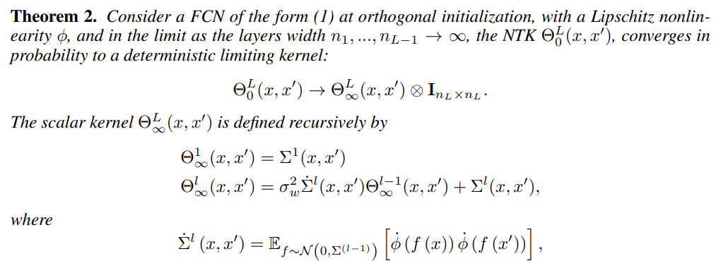
Theoretical results
Theoretically NTK of orthogonal and Gaussian initialization converges to the same deterministic kernel of a network initialized in the infinite-width.

Slide 12
Theoretical results
NTK of a network with an orthogonal initialization stays asymptotically constant during gradient descent training, providing a guarantee for loss convergence.

Slide 13
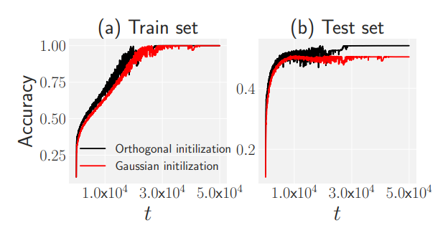
Numerical Experiments
Numerical experiment on Gaussian and Orthogonal initialization is also experimented with CIFAR10 and MNIST dataset.
As expected, in shallow networks, two initialization methods are similar.
But for deep neural network, which is far from assumptions of NTK, orthogonal initialization showed faster convergence and higher generalization performance.
shallow networks
deep networks with large learning rate

Slide 14
Conclusion
Theoretically NTK of orthogonal and Gaussian initialization converges to the same deterministic kernel of a network initialized in the infinite-width.
NTK of orthogonal and gaussian initializations of different architectures varies at a rate of the same order.
Theoretically dynamics of wide networks behaves similarly in orthogonal initialization and Gaussian initialization.
However numerically orthogonal initialization actually performs better in large learning rate, but not explained by NTK.

Slide 15
Project Topic
Title: An Analysis of Neural Network Initializations using Neural Tangent Kernel.
Motivation:
Initialization is known to be very important in the training dynamics of deep neural networks.
NTK is expected to be sensitive to initialization methods as lazy regime of NTK is first order approximation near its initialization value.

Slide 16
Project method
Method:
Roughly analyze the effect of different initialization methods such as with NTK.
Empirically compare NTK of networks with different initializations.
Target initializations:
Constant initialization, i.e.) 0, 1 initialization
Random initializations with different means and variances
Orthogonal initialization
Xavier, He initializations depending on activation functions.

Slide 17
Thanks for listening :)

